Slide 1
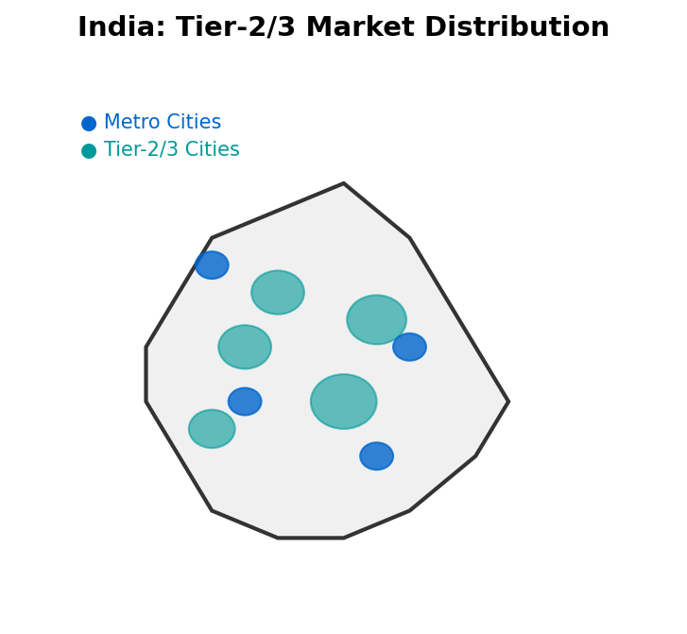
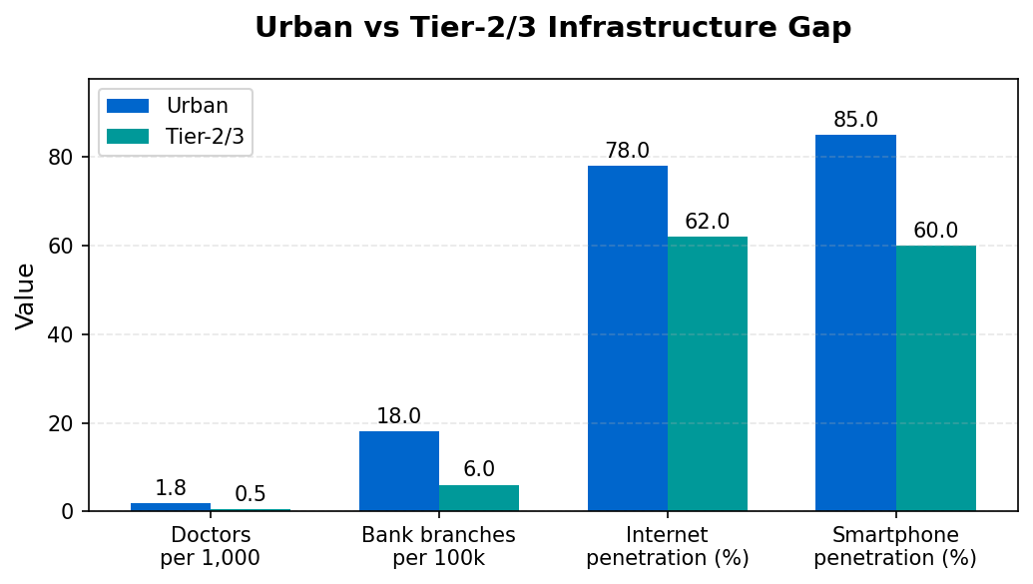
Why Tier-2 & Tier-3 India are Ripe for Disruption
India's Tier-2 and Tier-3 cities are no longer peripheral — they are fast becoming the engines of economic growth. With rising digital penetration and UPI-led inclusion, these markets are digitally ready yet structurally underserved, creating fertile ground for technology-led disruption.
📊 MACRO TRENDS
🎯 UNDERSERVED SECTORS
💰
Contribute ~45% of India's GDP by 2025
🏥
Healthcare: 600M underserved; 50+ km avg travel
👥
Population base ~650M
📚
Education: Teacher-student ratio 1:60 vs 1:30 norm
📱
Smartphone penetration ~60% (vs 78% urban)
💳
UPI → >12B transactions/month (2025)
🏦
Finance: 190M unbanked; <5% insured
📡
Mobile data = cheapest globally (~$0.17/GB)
🌾
Agriculture: Post-harvest losses ~₹90,000 Cr annually
Digital readiness + structural gaps = fertile ground for disruption
Presented By — Nakul Nandanwar, Vaishnavi Bhangale, Rahul Kumbhare
1

Slide 2
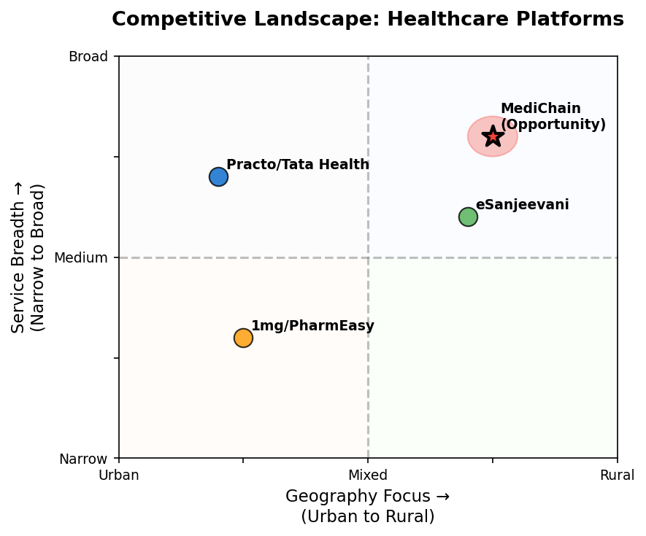
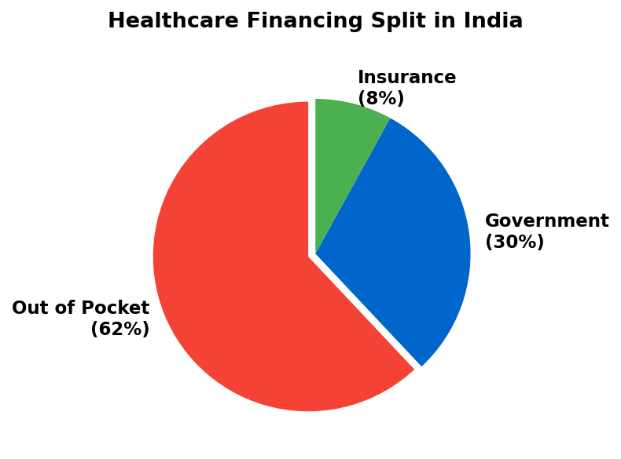
Healthcare in Tier-2/3 India: Urgent Problem, Large Market
🏥 Accessibility
💰 Affordability
🤝 Awareness & Trust
• 75% doctors urban → 600M underserved
• 50+ km avg travel
• OOP = 62% of spend
• 60M fall into poverty yearly
• Preventive stigma
• Reliance on unqualified practitioners
📈 MARKET POTENTIAL
Healthcare market USD 372B by 2025 • CAGR ~22%
Telemedicine USD 5.4B by 2025 • Growing rapidly
Diagnostics CAGR ~20% • High demand
eSanjeevani 160M+ teleconsults • Proof of adoption
Healthcare = burning platform → unmet need + adoption proof + policy push
Presented By — Nakul Nandanwar, Vaishnavi Bhangale, Rahul Kumbhare
2

Slide 3
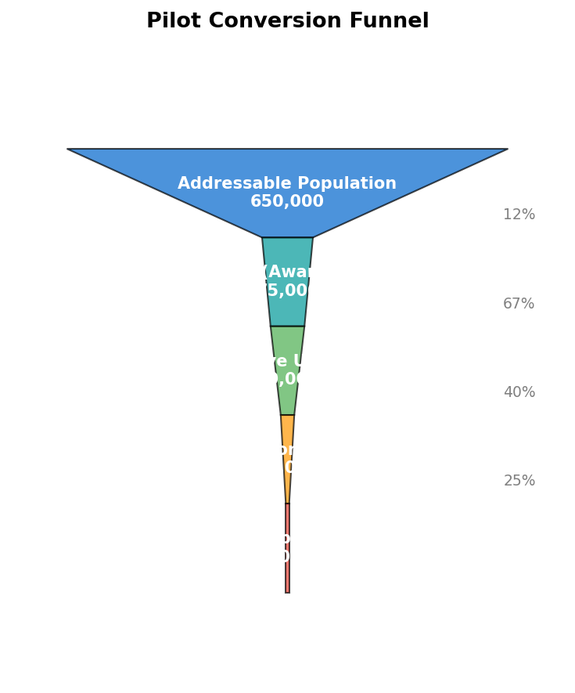
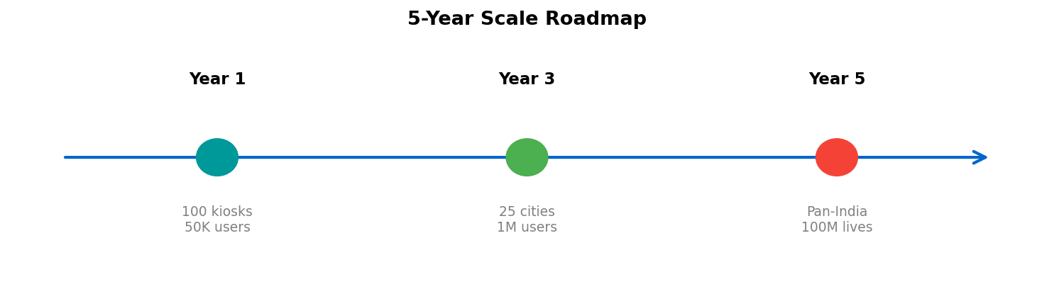
MediChain — Tech-enabled Primary Care & Diagnostics
🤖
🔬
🔗
💊
AI Symptom Triage
Vernacular chatbot Triage <₹20
IoT Diagnostic Kiosks
BP, sugar, ECG, SPO₂ Cost ~₹1L per kiosk
Blockchain Health Records
NDHM aligned Secure, portable
Phygital Linkages
Local pharmacies Last-mile medicine
⭐ KEY DIFFERENTIATORS
🗣️ Vernacular-first UX for regional adoption
💰 Affordable: <₹100 consults, ₹499/year family plan
🤝 Trust: Kiosk placement in pharmacies + NGO/state tie-ups
🎯 IMPACT & SCALE
Economic Impact:
• Low OOP burden for families
• Scalable subscription revenue
• Job creation in rural areas
Social Impact:
• Access for 100M+ underserved
• Preventive care culture
• SDG-3 alignment
MediChain = Vernacular, trust-first, affordable healthcare pathway for Bharat
Presented By — Nakul Nandanwar, Vaishnavi Bhangale, Rahul Kumbhare
3

